Slide 1
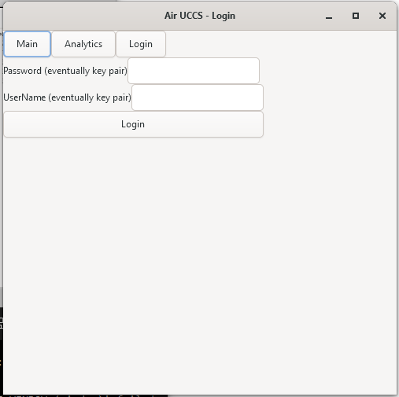
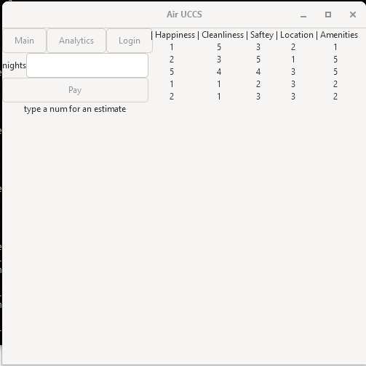
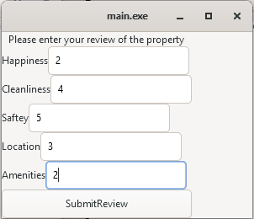
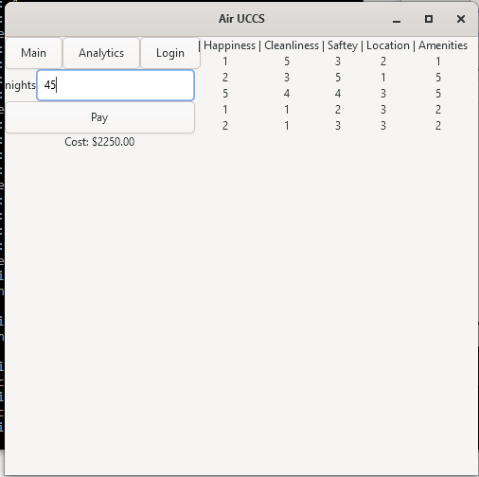
AIR UCCS
Project Retro
-Mattie Fuller
CC-BY-NC-SA 4.0

Slide 2
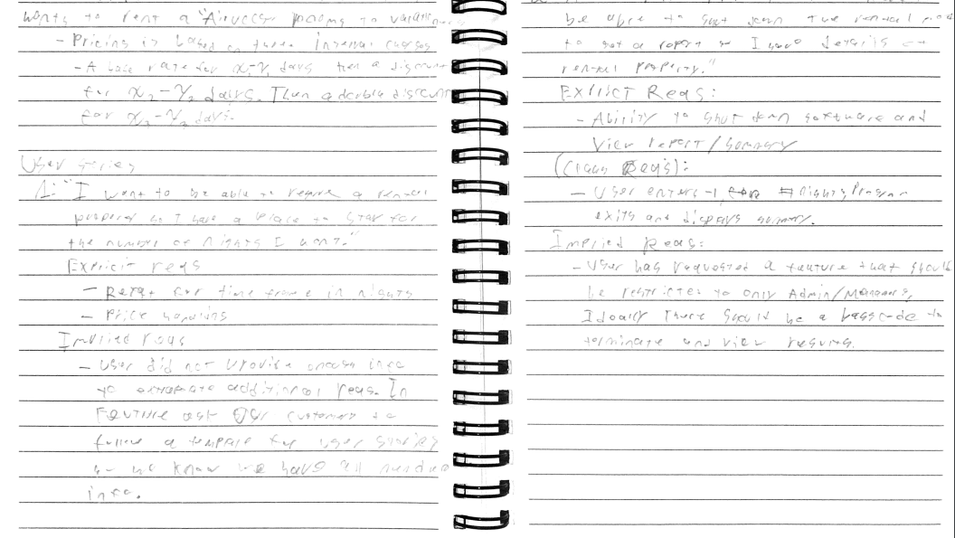
Part 1: Analysis of Requirements
User Stories
Explicit requirements
Implicit requirements
Test Case

Slide 3
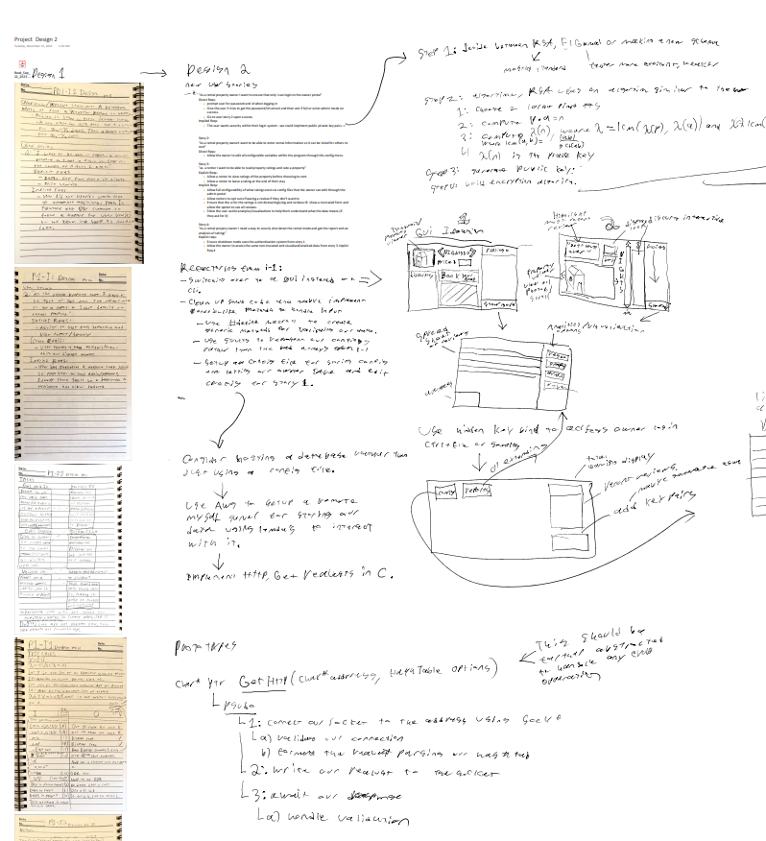
User Stories

Slide 4
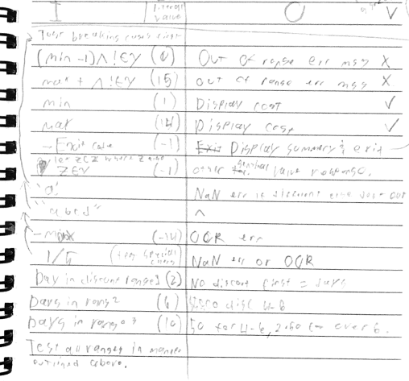
Test Cases

Slide 5
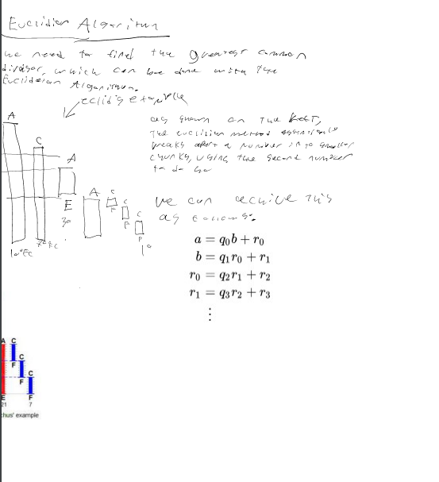
Designing & Pseudocode (Algorithms)

Slide 6
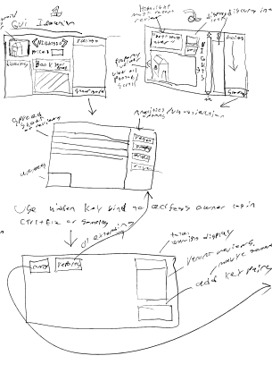
Designing UI and iterative design

Slide 7
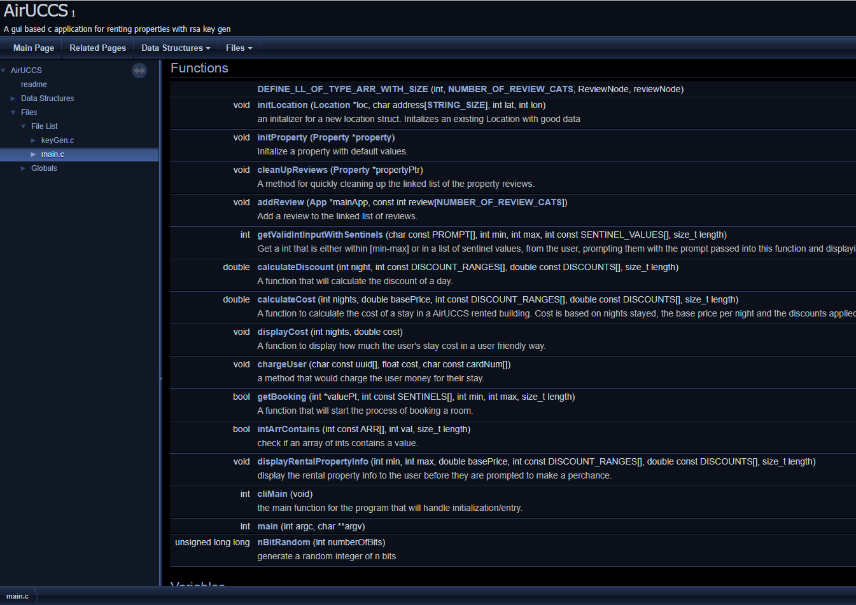
Maintainability & Extendibility
Fully documented API
Extendable code
https://mattiefm.github.io/CS2060ClassCode2023/

Slide 8
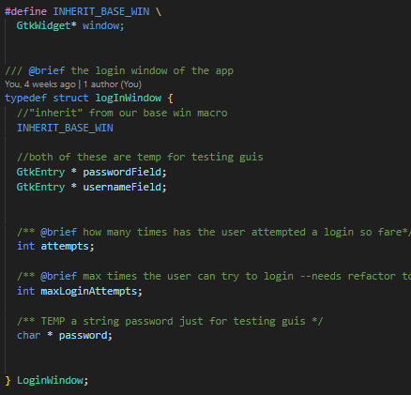
Extendibility Example:
Psudo-inhairitance by way of macros

Slide 9
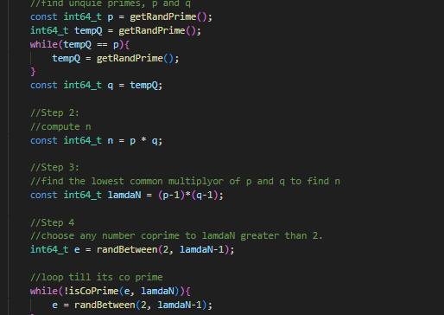
Quality Readable Code
Line comments for complex things
Documentation comments for everything
(example from RSAKeyGen)

Slide 10

Secure Code Example 1
Passing const arrays to functions that do not edit the array

Slide 11
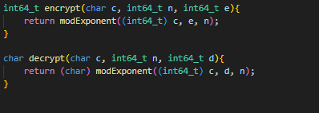
Secure Code Example 2
RSA Keygen Encryption and Decrpytion

Slide 12
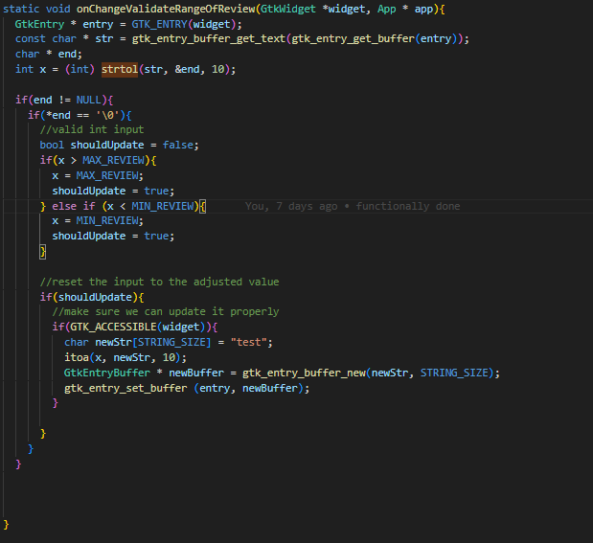
Input validation

Slide 13
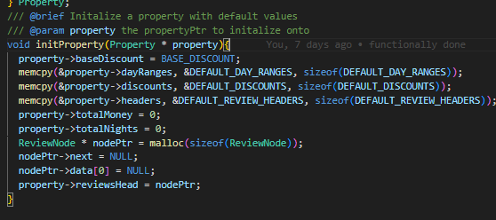
Principle of Least privilege

Slide 14
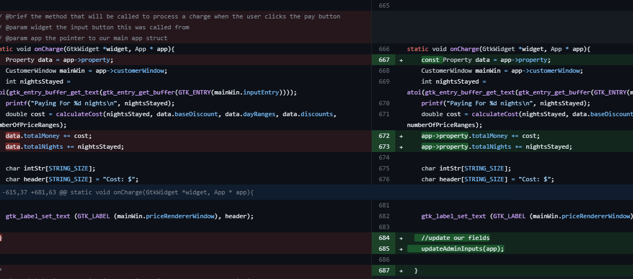
Refactoring

